Slide 1
Structured Query Language (SQL)

Slide 2
Introduction:
SQL stands for Structured Query Language
SQL lets you access and manipulate databases
SQL became a standard of the American National Standards Institute (ANSI) in 1986, and of the International Organization for Standardization (ISO) in 1987
Structured Query Language is a standard Database language that is used to create, maintain, and retrieve the relational database. SQL is case insensitive.

Slide 3
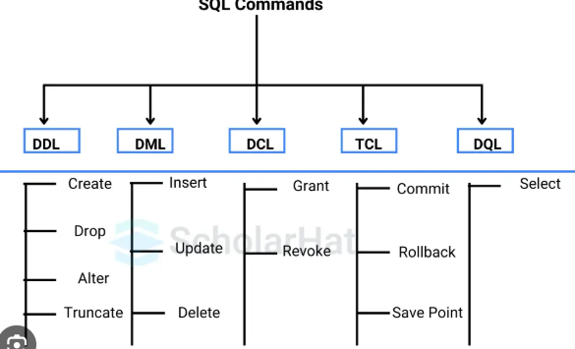
Basic Structure:
DDL (Data Definition Language)
DML (Data Manipulation Language)
DQL (Data Query Language)
DCL (Data Control Language)
TCL (Transaction Control Language)

Slide 4
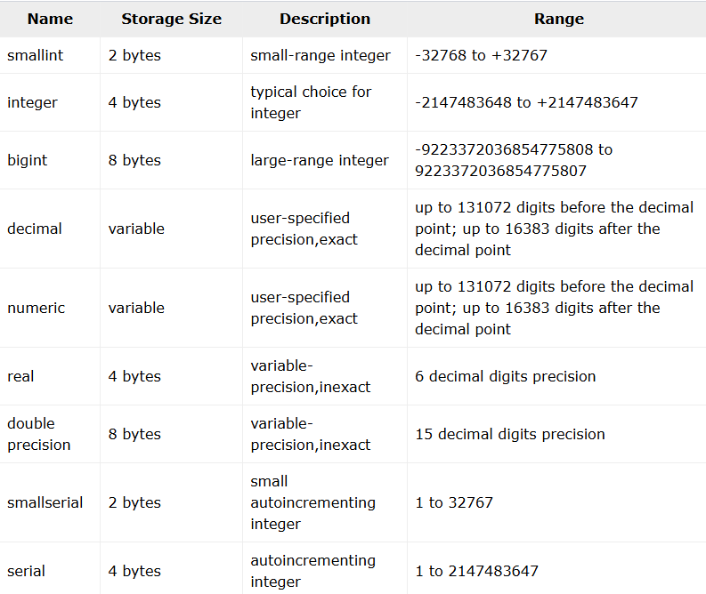
Basic Data Types
Numeric Types

Slide 5
Basic Data Types
Character Types
character varying(n), varchar(n)
variable-length with limit
character(n), char(n)
fixed-length, blank padded
text
variable unlimited length

Slide 6
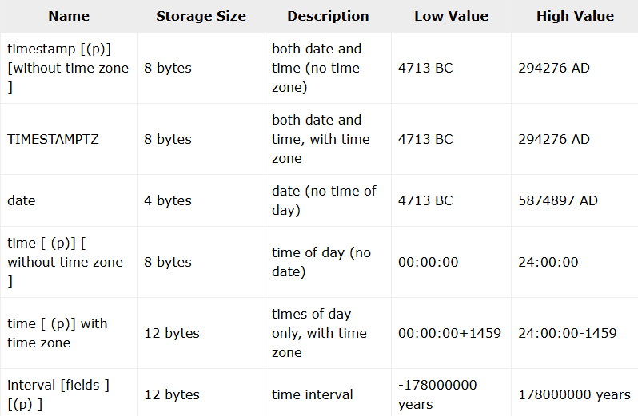
Date/Time Types

Slide 7

Binary Data Types & Boolean Type
Enumerated Type

Slide 8
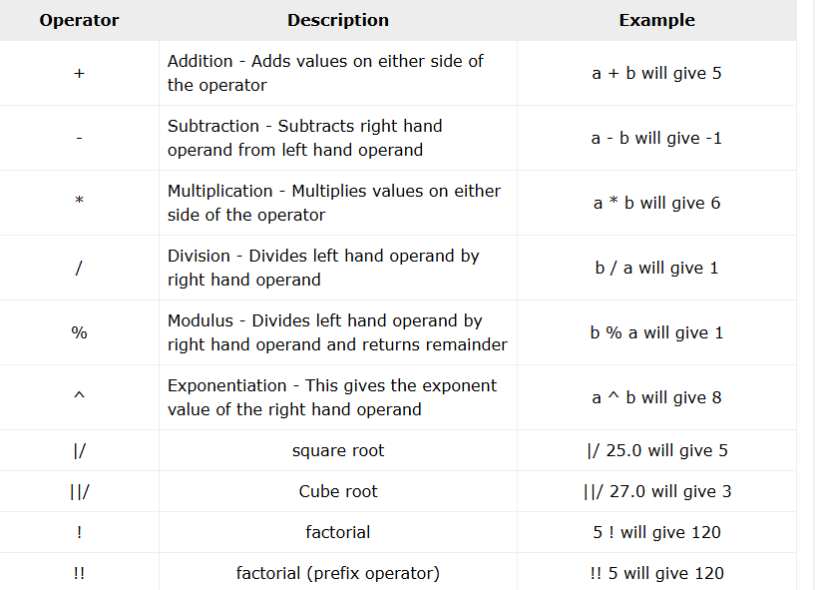
PostgreSQL - Operators
Arithmetic operators
Comparison operators
Logical operators
Bitwise operators

Slide 9
PostgreSQL - CREATE Database
Syntax
CREATE DATABASE dbname;
Example
postgres=# CREATE DATABASE testdb;
postgres-#
ALTER DATA BASE:
ALTER DATABASE is used to modify the properties of an existing database, such as renaming the database, changing the owner of the database
Syntax
ALTER DATABASE name ACTION

Slide 10
PostgreSQL Database
DROP Database
Syntax
DROP DATABASE [ IF EXISTS ] name
Where,
IF EXISTS
Do not throw an error if the database does not exist.
name
The name of the database to remove.
Example
postgres=# DROP DATABASE testdb;
postgres-#

Slide 11
PostgreSQL Database
RENAME DATABASE
The RENAME DATABASE is used to change the name of the database.
Syntax:
ALTER DATABASE old_database_name RENAME TO new_database_name;
Where,
old_database_name : The database which is already exists.
new_database_name : The new name of the database.
SELECT Database
check the available database list using \l, i.e., backslash
to connect/select a desired database

Slide 12
CREATE TABLE
CREATE TABLE statement is used to create a new table in any of the given database.
Syntax:
CREATE TABLE table_name(
column1 datatype,
column2 datatype,
column3 datatype,
.....
columnN datatype,
PRIMARY KEY( one or more columns )
);

Slide 13
CREATE TABLE
Example of CREATE TABLE
CREATE TABLE COMPANY(
ID INT PRIMARY KEY NOT NULL,
NAME TEXT NOT NULL,
AGE INT NOT NULL,
ADDRESS CHAR(50),
SALARY REAL
);

Slide 14
INSERT
INSERT INTO statement allows user to insert one or new rows into a table. One can insert a single row at a time or several rows as a result of a query.
Syntax:
INSERT INTO TABLE_NAME (column1, column2, column3, ..., columnN)
VALUES (value1, value2, value3, ..., valueN);
Where,
column1, column2,...columnN are the names of the columns in the table into which you want to insert data.
The target column names can be listed in any order. The values supplied by the VALUES clause or query are associated with the explicit or implicit column list left-to-right.

Slide 15
INSERT
Example:
INSERT INTO COMPANY (ID, NAME, AGE, ADDRESS, SALARY, JOIN_DATE) VALUES (1, 'Paul', 32, 'California', 20000.00, '2001-07-13');

Slide 16
WHERE clause
WHERE clause is a critical component of SQL queries, allowing users to filter records based on specified conditions. By using the WHERE clause, we can retrieve only the rows that meet our specific criteria, making it an essential tool for data manipulation and querying in PostgreSQL. The WHERE clause can be used in SELECT, UPDATE, DELETE and other SQL statements to control which records are affected or returned.
Syntax:
SELECT column1, column2, ... FROM table_name WHERE condition;
SELECT column1, column2, ...: Specifies the columns that you want to retrieve. You can select one or more columns from a table.
FROM table_name: Indicates the table from which the data will be selected. This is the table that contains the rows to be filtered.
WHERE condition: This is the core of the WHERE clause, where you define the condition that must be met for rows to be included in the result set. Only rows that satisfy the condition will be returned by the query.

Slide 17
WHERE Clause with the Equal (=) Operator
SELECT last_name, first_name FROM customer WHERE first_name = ‘ABC';
WHERE Clause with the AND Operator
SELECT last_name, first_name FROM customer WHERE first_name = ‘Swati' AND last_name = ‘Patil';

Slide 18
WHERE Clause with the OR Operator
SELECT first_name, last_name FROM customer WHERE last_name = 'Cooper' OR first_name = 'Jo';
WHERE Clause with the IN Operator
SELECT first_name, last_name FROM customer WHERE first_name IN ('Kelly', 'Jo', ' Alexander');

Slide 19
WHERE Clause with the LIKE Operator
SELECT first_name, last_name FROM customer WHERE first_name LIKE 'Kath%';
WHERE Clause with the BETWEEN Operator
SELECT first_name, LENGTH(first_name) name_length FROM customer WHERE first_name LIKE 'K%' AND LENGTH(first_name) BETWEEN 3 AND 7

Slide 20
WHERE Clause with the Not Equal Operator (<>)
SELECT first_name, last_name FROM customer WHERE first_name LIKE 'Bra%' AND last_name <> 'Motley';

Slide 21
AVG Function
The AVG() function returns the average value of a numeric column.
Example:
SELECT AVG(price)
FROM products;
With 2 Decimals
We can use the ::NUMERIC operator to round the average price to a number with 2 decimals:
Example:
SELECT AVG(price)::NUMERIC(10,2) FROM products;

Slide 22
MIN and MAX Functions
MIN
The MIN() function returns the smallest value of the selected column.
Example:
SELECT MIN(price)
FROM products;
MAX
The MAX() function returns the largest value of the selected column.
Example:
SELECT MAX(price) FROM products;

Slide 23
COUNT Function
The COUNT() function returns the number of rows that matches a specified criterion.
Example
SELECT COUNT(customer_id) FROM customers;
Note: NULL values are not counted.
By specifying a WHERE clause, you can e.g. return the number of customers that comes from London:
Example:
SELECT COUNT(customer_id) FROM customers WHERE city = 'London';

Slide 24
SUM Function
The SUM() function returns the total sum of a numeric column.
Example
SELECT SUM(quantity) FROM order_details;

Slide 25
ORDER BY
Sort Data
The ORDER BY keyword is used to sort the result in ascending or descending order.
The ORDER BY keyword sorts the records in ascending order by default. To sort the records in descending order, use the DESC keyword.
Example
SELECT * FROM products ORDER BY price;
Example
Sort the table by price, in descending order:
SELECT * FROM products ORDER BY price DESC;

Slide 26
Sort Alphabetically
For string values the ORDER BY keyword will order alphabetically:
Example
Sort the table by product name:
SELECT * FROM products ORDER BY product_name;
Alphabetically DESC
To sort the table reverse alphabetically, use the DESC keyword:
Example
Sort the table by product name, in descending order:
SELECT * FROM products ORDER BY product_name DESC;

Slide 27
SELECT DISTINCT
The SELECT DISTINCT statement is used to return only distinct (different) values.
Example
Select only the DISTINCT values from the country column in the customers table:
SELECT DISTINCT country FROM customers;
SELECT COUNT(DISTINCT)
We can also use the DISTINCT keyword in combination with the COUNT statement, which in the example below will return the number of different countries there are in the customers table.
Example
Return the number of different countries there are in the customers table:
SELECT COUNT(DISTINCT country) FROM customers;

Slide 28
The LIMIT Clause
The LIMIT clause is used to limit the maximum number of records to return.
Example
Return only the 20 first records from the customers table:
SELECT * FROM customers LIMIT 20;
The OFFSET Clause
The OFFSET clause is used to specify where to start selecting the records to return.
Example
Return 20 records, starting from the 41th record:
SELECT * FROM customers LIMIT 20 OFFSET 40;

Slide 29
HAVING Clause
The HAVING clause was added to SQL because the WHERE clause cannot be used with aggregate functions.
Aggregate functions are often used with GROUP BY clauses, and by adding HAVING we can write condition like we do with WHERE clauses.
Example
List only countries that are represented more than 5 times:
SELECT COUNT(customer_id), country FROM customers GROUP BY country HAVING COUNT(customer_id) > 5;

Slide 30
EXISTS Operator
The EXISTS operator is used to test for the existence of any record in a sub query.
The EXISTS operator returns TRUE if the sub query returns one or more records.
Example
Return all customers that is represented in the orders table:
SELECT customers.customer_name FROM customers WHERE EXISTS ( SELECT order_id FROM orders WHERE customer_id = customers.customer_id );

Slide 31
NOT EXISTS
To check which customers that do not have any orders, we can use the NOT operator together with the EXISTS operator :
Example
Return all customers that is NOT represented in the orders table:
SELECT customers.customer_name FROM customers WHERE NOT EXISTS ( SELECT order_id FROM orders WHERE customer_id = customers.customer_id );

Slide 32
ADD COLUMN in table
Example
Add a column named color:
ALTER TABLE cars ADD color VARCHAR(255);

Slide 33
The UPDATE Statement
The UPDATE statement is used to modify the value(s) in existing records in a table.
Example
Set the color of the Volvo to 'red':
UPDATE cars SET color = 'red' WHERE brand = 'Volvo';
Update Multiple Columns
To update more than one column, separate the name/value pairs with a comma ,:
Example
Update color and year for the Toyota:
UPDATE cars SET color = 'white', year = 1970 WHERE brand = 'Toyota';

Slide 34
The DELETE Statement
Example
Delete all records where brand is 'Volvo':
DELETE FROM cars WHERE brand = 'Volvo';
Delete All Records
Example
Delete all records in the cars table:
DELETE FROM cars;

Slide 35
Create table driver (licence_no, Name, Address) and perform the following queries
1. Add new column age with constraint that age should be greater than 20 years.
2. Alter table by modifying driver_name to varchar(50));
3. Alter table driver ,drop the column age.
4. Add new column Aadhar Number in diriver table
5. Remove the driver table from the database
Solution:
CREATE TABLE driver ( licence_no VARCHAR(20) PRIMARY KEY, Name VARCHAR(255), Address VARCHAR(255));
Add a new column age with a constraint:
ALTER TABLE driverADD COLUMN age INT CHECK (age > 20);
Modify the Name column to driver_name and increase its size:
ALTER TABLE driverRENAME COLUMN Name TO driver_name;ALTER TABLE driverMODIFY COLUMN driver_name VARCHAR(50);

Slide 36
Drop the age column:
ALTER TABLE driverDROP COLUMN age;
Add a new column aadhar_number:
ALTER TABLE driverADD COLUMN aadhar_number VARCHAR(12);
Remove the table:
DROP TABLE driver;

Slide 37
Create table Game (name, no-of-players, captain_name) and perform the following queries
1. Add new column game_no with constraint primary key.
2. Modify table by adding the column game_duration.
3. Add column game_type with values cricket,hockey,tennis.
4. Remove game table from the database
Solution:
CREATE TABLE Game ( name VARCHAR(255), no_of_players INT, captain_name VARCHAR(255));
Add new column game_no with constraint primary key.
ALTER TABLE GameADD COLUMN game_no INT PRIMARY KEY;
2. Modify table by adding the column game_duration.
ALTER TABLE Game ADD COLUMN game_duration INT;
3. Add column game_type with values cricket,hockey,tennis.
ALTER TABLE GameADD COLUMN game_type VARCHAR(255) CHECK (game_type IN ('cricket', 'hockey', 'tennis'));
4. Remove game table from the database
DROP TABLE Game;

Slide 38
Create table Emp (eno, ename, salary) and perform the following queries
1. Add primary key constraint to eno
2. Add column contact_number to employee table.
3. Alter table by modifying ename to varchar(50));
4. Add column designation with values ‘Manager’,’Accountant’,’Worker’
5. Alter table employee drop column salary
Solution:
CREATE TABLE Emp (
eno INT,
ename VARCHAR(255),
salary DECIMAL(10, 2)
);
1. Add primary key constraint to eno
ALTER TABLE Emp ADD PRIMARY KEY (eno);

Slide 39
2. Add column contact_number to employee table
ALTER TABLE Emp ADD contact_number VARCHAR(20);
3. Alter table by modifying ename to varchar(50)
ALTER TABLE Emp MODIFY COLUMN ename VARCHAR(50);
4. Add column designation with values ‘Manager’,’Accountant’,’Worker’
ALTER TABLE Emp ADD designation VARCHAR(20) CHECK (designation IN ('Manager', 'Accountant', 'Worker'));
5. Alter table employee drop column salary
ALTER TABLE Emp DROP COLUMN salary;

Slide 40
FOREIGN KEY Constraint
A FOREIGN KEY is a field (or collection of fields) in one table, that refers to the PRIMARY KEY in another table.
The table with the foreign key is called the child table, and the table with the primary key is called the referenced or parent table.
Syntax for Foreign Key:
CREATE TABLE child_table (
column1 datatype,
column2 datatype,
...
CONSTRAINT fk_name FOREIGN KEY (foreign_key_column)
REFERENCES parent_table(primary_key_column)
);

Slide 41
FOREIGN KEY Constraint
Create Parent Table (Departments)
CREATE TABLE departments (
department_id int PRIMARY KEY,
department_name VARCHAR(100) NOT NULL
);
Create Child Table (Employees)
CREATE TABLE employees (
employee_id int PRIMARY KEY,
employee_name VARCHAR(100) NOT NULL,
department_id INT,
CONSTRAINT fk_department FOREIGN KEY (department_id)
REFERENCES departments(department_id)
);

Slide 42
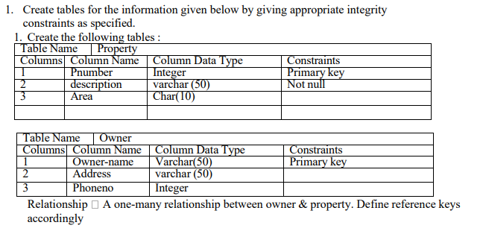

Slide 43
CREATE TABLE owners ( id int PRIMARY KEY, name VARCHAR(100), email VARCHAR(100) );
CREATE TABLE properties ( id SERIAL PRIMARY KEY, address VARCHAR(255), owner_id INTEGER, FOREIGN KEY (owner_id) REFERENCES owners(id) );

Slide 44
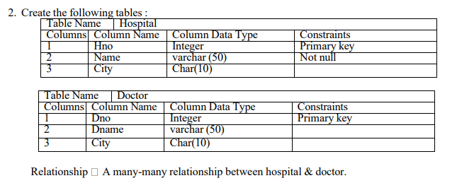

Slide 45
Create the Hospital and Doctor tables:
CREATE TABLE Hospital ( hospital_id int PRIMARY KEY, hospital_name VARCHAR(255) NOT NULL, address VARCHAR(255));
CREATE TABLE Doctor ( doctor_id int PRIMARY KEY, doctor_name VARCHAR(255) NOT NULL, specialization VARCHAR(255));
CREATE TABLE HospitalDoctor ( hospital_id INTEGER NOT NULL, doctor_id INTEGER NOT NULL, PRIMARY KEY (hospital_id, doctor_id), FOREIGN KEY (hospital_id) REFERENCES Hospital(hospital_id), FOREIGN KEY (doctor_id) REFERENCES Doctor(doctor_id));

Slide 46
Create the following tables ( primary keys are underlined.). Property(pno,description, area)
Owner(oname,address,phone)
An owner can have one or more properties, but a property belongs to exactly one owner. Create the relations accordingly, so that the relationship is handled properly.
a) Insert 5 records into owner table.
b) insert 5 property records for each owner .
c) Update phone no of “Mr. Patil” to 9800566330
d) Display the name of owner who lives in ‘Mumbai’
e) Delete all properties from “pune” owned by “ Mr. Nene”

Slide 47
CREATE TABLE Owner ( oname VARCHAR(25) PRIMARY KEY, address VARCHAR(255), phone VARCHAR(20) );
CREATE TABLE Property ( pno INT PRIMARY KEY, description VARCHAR(50), area VARCHAR(20), oname VARCHAR(25), FOREIGN KEY (oname) REFERENCES Owner(oname) );

Slide 48
-- a) Insert 5 records into owner table INSERT INTO Owner VALUES ('Mr. Patil', 'Pune', '9876543210'), ('Mr. Sharma', 'Mumbai', '9988776655'), ('Mr. Mehta', 'Delhi', '9123456789'), ('Mr. Nene', 'Pune', '8877665544'), ('Mr. Joshi', 'Bangalore', '7766554433'); -- b) Insert 5 property records for each owner INSERT INTO Property VALUES (1, 'Flat', 'Pune', 'Mr. Patil'), (2, 'Bunglow', 'Pune', 'Mr. Patil'), (3, 'Apartment', 'Mumbai', 'Mr. Patil'), (4, 'Villa', 'Pune', 'Mr. Patil'), (5, 'Penthouse', 'Mumbai', 'Mr. Patil'), (6, 'Flat', 'Mumbai', 'Mr. Sharma'), (7, 'Bunglow', 'Delhi', 'Mr. Sharma'), (8, 'Apartment', 'Bangalore', 'Mr. Sharma'), (9, 'Villa', 'Delhi', 'Mr. Sharma'), (10, 'Penthouse', 'Bangalore', 'Mr. Sharma'), (11, 'Flat', 'Delhi', 'Mr. Mehta'), (12, 'Bunglow', 'Bangalore', 'Mr. Mehta'), (13, 'Apartment', 'Pune', 'Mr. Mehta'),

Slide 49
c) Update phone no of “Mr. Patil” to 9800566330
UPDATE Owner SET phone = '9800566330' WHERE oname = 'Mr. Patil';
d) Display the name of owner who lives in ‘Mumbai’
SELECT oname FROM Owner WHERE address = 'Mumbai';
e) Delete all properties from “pune” owned by “ Mr. Nene”
DELETE FROM Property WHERE oname = 'Mr. Nene' AND area = 'Pune';

Slide 50
Create the following tables ( primary keys are underlined.).
Emp(eno,ename,designation,sal)
Dept(dno,dname,dloc)
There exists a one-to-many relationship between emp & dept. Create the Relations accordingly, so that the relationship is handled properly and the relations are in normalized form (3NF).
a) Insert 5 records into department table
b) Insert 5 employee records for each department.
c) increase salary of “managers” by 15%;
d) delete all employees of deparment no 5;
e)change location of department 2 to ‘Mumbai’

Slide 51
CREATE TABLE Dept ( dno INT PRIMARY KEY, dname VARCHAR(255), dloc VARCHAR(255) );
CREATE TABLE Emp ( eno INT PRIMARY KEY, ename VARCHAR(255), designation VARCHAR(255), sal DECIMAL(10, 2), dno INT, FOREIGN KEY (dno) REFERENCES Dept(dno) );

Slide 52
Insert 5 records into department table INSERT INTO Dept VALUES (1, 'Sales', 'New York'), (2, 'Marketing', 'Los Angeles'), (3, 'Engineering', 'Chicago'), (4, 'Finance', 'San Francisco'), (5, 'HR', 'Boston');
Insert 5 employee records for each department INSERT INTO Emp (eno, ename, designation, sal, dno) VALUES (101, 'John Smith', 'Manager', 60000.00, 1), (102, 'Jane Doe', 'Analyst', 45000.00, 1), (103, 'Peter Jones', 'Salesperson', 40000.00, 1), (104, 'Mary Brown', 'Manager', 65000.00, 2), (105, 'David Wilson', 'Analyst', 50000.00, 2), (106, 'Sarah Lee', 'Marketing Specialist', 42000.00, 2), (107, 'Robert Garcia', 'Engineer', 70000.00, 3), (108, 'Linda Williams', 'Engineer', 65000.00, 3), (109, 'Michael Davis', 'Accountant', 55000.00, 4), (110, 'Patricia Rodriguez', 'Analyst', 48000.00, 4),

Slide 53
c) increase salary of “managers” by 15%
UPDATE Emp SET sal = sal * 1.15 WHERE designation = 'Manager';
d) delete all employees of department no 5
DELETE FROM Emp WHERE dno = 5; e) change location of department 2 to 'Mumbai'
UPDATE Dept SET dloc = 'Mumbai' WHERE dno = 2;

Slide 54
Consider the following database
Person (pnumber, pname, birthdate, income)
Area (aname, area_type,pincode)
The relationship is as follows:
Person-Area:many-to-one.The‘area_type’can have values ‘Urban’ and ‘Rural’ Create normalized tables (3NF) for the above and solve the following queries. Write & execute insert/ update / delete statements for following business tasks
a) Insert 5 records in the Person table.
b) Insert 3 records in the Area table
c) List the names of all people income less than 100000
d) Change the pincode of ‘kalyaninagar’ to411036.

Slide 55
Person:
pnumber (INT, Primary Key)
pname (VARCHAR)
birthdate (DATE)
income (DECIMAL)
aname (VARCHAR, Foreign Key referencing Area.aname)
Area:
aname (VARCHAR, Primary Key)
area_type (VARCHAR)
pincode (INT)

Slide 56
INSERT INTO Person VALUES
(1, 'Alice', '1990-05-15', 75000, 'A1'),
(2, 'Bob', '1985-10-20', 120000, 'A2'),
(3, 'Charlie', '1992-03-10', 90000, 'A1'),
(4, 'David', '1988-07-05', 60000, 'A3'),
(5, 'Emily', '1995-12-01', 110000, 'A2');
INSERT INTO Area VALUES
('A1', 'Urban', 411014),
('A2', 'kalyaninagar', 411001),
('A3', 'Rural', 411028);

Slide 57
List the names of all people with income less than 100000:
SELECT pname FROM Person WHERE income < 100000;
Change the pincode of 'kalyaninagar' to 411036:
UPDATE Area SET pincode = 411036 WHERE aname = 'A1';

Slide 58
Create the following tables ( primary keys are underlined).
Emp (eno, ename, salary)
Project (pno, pname, budget)
Relationships: Emp–Project : M – M with descriptive attribute no-of-hrs.Create normalized tables (3NF) for the above and solve the following queries. Write & execute insert/ update / delete statements for following business tasks
a) Insert 5 records in the Employee table.
b) Insert 5 records in the Project table.
c) Increase the salary of all employees by10%
d) Display all employee whose salary between 40000 to 70000
e) Delete all project whose project budget is greater than 300000

Slide 59
CREATE TABLE Emp ( eno INT PRIMARY KEY, ename VARCHAR(255), salary DECIMAL(10, 2) ); CREATE TABLE Project ( pno INT PRIMARY KEY, pname VARCHAR(255), budget DECIMAL(15, 2) ); CREATE TABLE Emp_Project ( eno INT, pno INT, no_of_hrs INT, PRIMARY KEY (eno, pno), FOREIGN KEY (eno) REFERENCES Emp(eno) on delete cascade, FOREIGN KEY (pno) REFERENCES Project(pno) on delete cascade );

Slide 60
INSERT INTO Emp (eno, ename, salary) VALUES (1, 'Alice', 50000.00), (2, 'Bob', 65000.00), (3, 'Charlie', 45000.00), (4, 'David', 75000.00), (5, 'Eve', 60000.00);
INSERT INTO Project (pno, pname, budget) VALUES (101, 'Alpha Project', 250000.00), (102, 'Beta Project', 350000.00), (103, 'Gamma Project', 180000.00), (104, 'Delta Project', 400000.00), (105, 'Epsilon Project', 290000.00);
INSERT INTO Emp_Project (eno, pno, no_of_hrs) VALUES (1, 101, 160), (2, 101, 120), (3, 103, 80), (4, 105, 200), (5, 103, 90);

Slide 61
Increase the salary of all employees by 10%.
UPDATE EmpSET salary = salary * 1.10;
Display all employees whose salary is between 40000 to 70000.
SELECT eno, ename, salaryFROM EmpWHERE salary BETWEEN 40000 AND 70000;
Delete all projects whose project budget is greater than 300000.
DELETE FROM ProjectWHERE budget > 300000.00;

